Slide 1

Assessing Land Law
School of Law
Faculty of Education Social Sciences and Law
Adam Baker
Lecturer in Property Law
University of Leeds

Slide 2
1. Introduction -
‘The assessment that students undergo communicates to them what really matters in our courses; it strongly influences students’ learning, including what they study, when they study, how much work they do and the approach they take to their learning.
Consequently, if we want to improve students’ learning, effort and achievement, assessment is a good place to start.’
Sue Bloxham (2014)
Bloxham, S., ‘Assessing assessment: new developments in assessment design, feedback practices and marking in higher education’ in H. Fry, S. Ketteridge and S. Marshall (eds.), A Handbook for Learning and Teaching in Higher Education (Routledge, London 2015), 107.

Slide 3
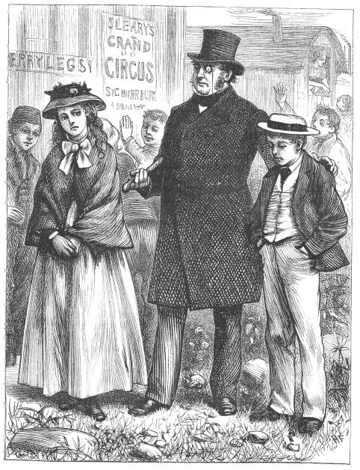
1. Introduction -
“In this life, we want nothing
but Facts, sir; nothing but Facts!”
Mr Gradgrind,
Hard Times (1854)

Slide 4
2. Current practice -
What are we doing at present?
A perusal through land law modules as offered by Russell Group institutions suggests a fairly even mix between:
exam only assessment; and
exam and essay assessment (usually weighted around 2/3 to 1/3 respectively).

Slide 5
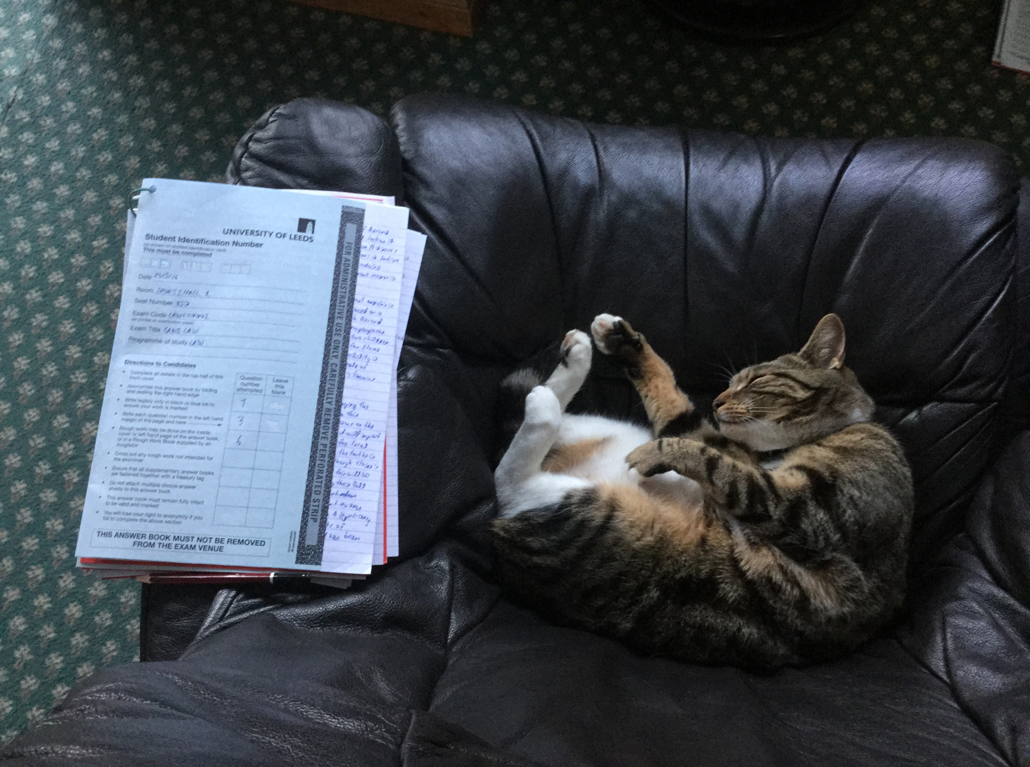
2. Current practice -
The educational literature encourages us to diversify our assessment.

Slide 6

3. Leeds experience -
A presentation assessment was first introduced in 15/16. It is worth 25%.*
Students are allocated to designated parts in a ‘group title’. They are assessed equally between presentational skills and content**. Banded marking is used.
* The exam must still be passed.
** One cannot pass unless the
content is of a pass standard!

Slide 7
3. Leeds experience -
‘Improving the quality of presentation actually improves the quality of thought, and vice versa. This is the ultimate result of a successful presentation.’
Slađana Živković (2014)
S. Živković, ‘The Importance of Oral Presentations for Students’ (2014) 5 Mediterranean Journal of Social Sciences 468, 474.

Slide 8
3. Leeds experience -
Plusses:
Positive student feedback
Useful perspective for markers
Allowing students to learn from each other?
There are still some things to be worked on!

Slide 9

4. The SQE -
The SQE may underpin the need for exams – but does it also leave more room for skills?
Perhaps other factors may exert more influence in this respect.

