Slide 1
A land law syllabus?
Professor Antonia Layard
University of Bristol

Slide 2
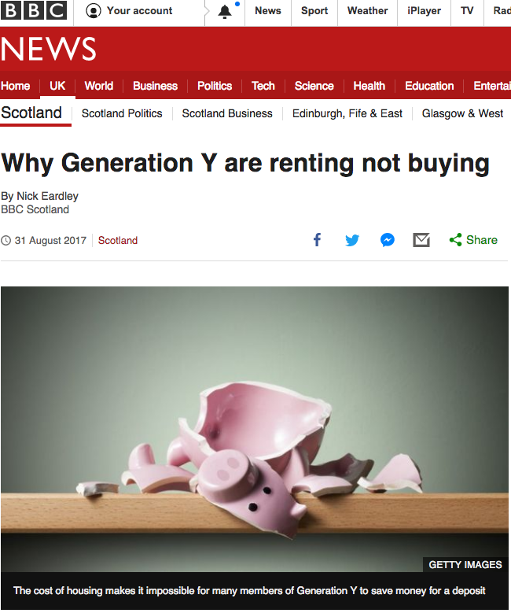

Slide 3
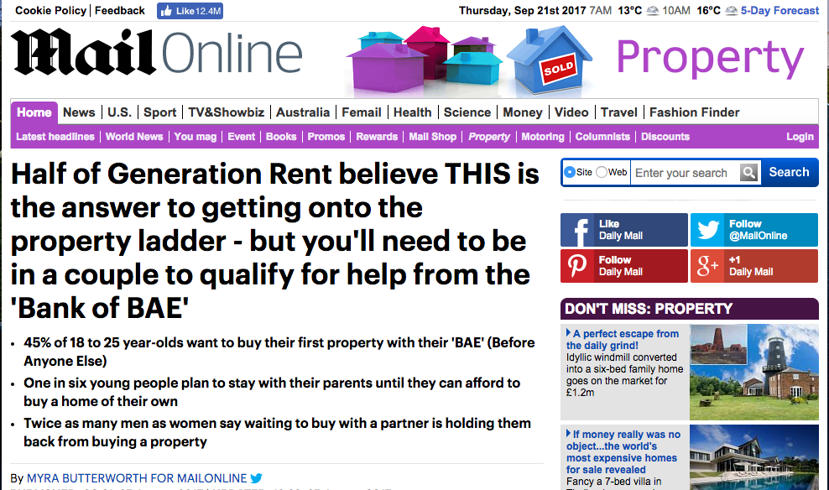
Notes:
https://chandlerozconsultants.wordpress.com/tag/birmingham-immigration-control-association/ The Windrush Generation: One of the first Jamaican immigrants seeking work and lodgings in Birmingham in 1955.

Slide 4
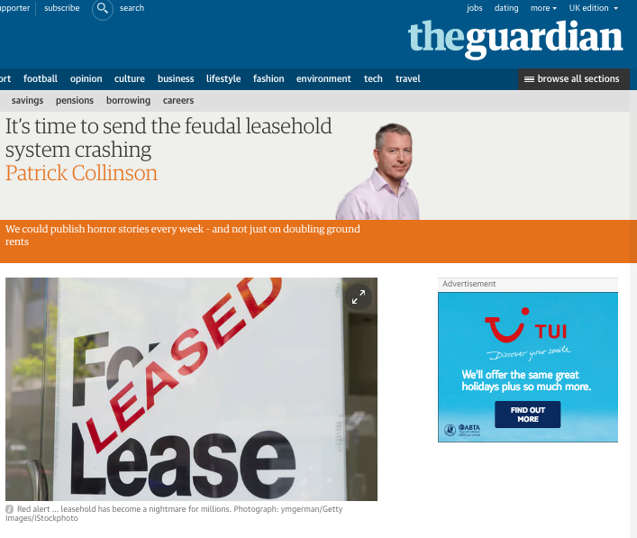

Slide 5
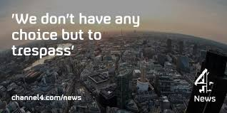


Slide 6
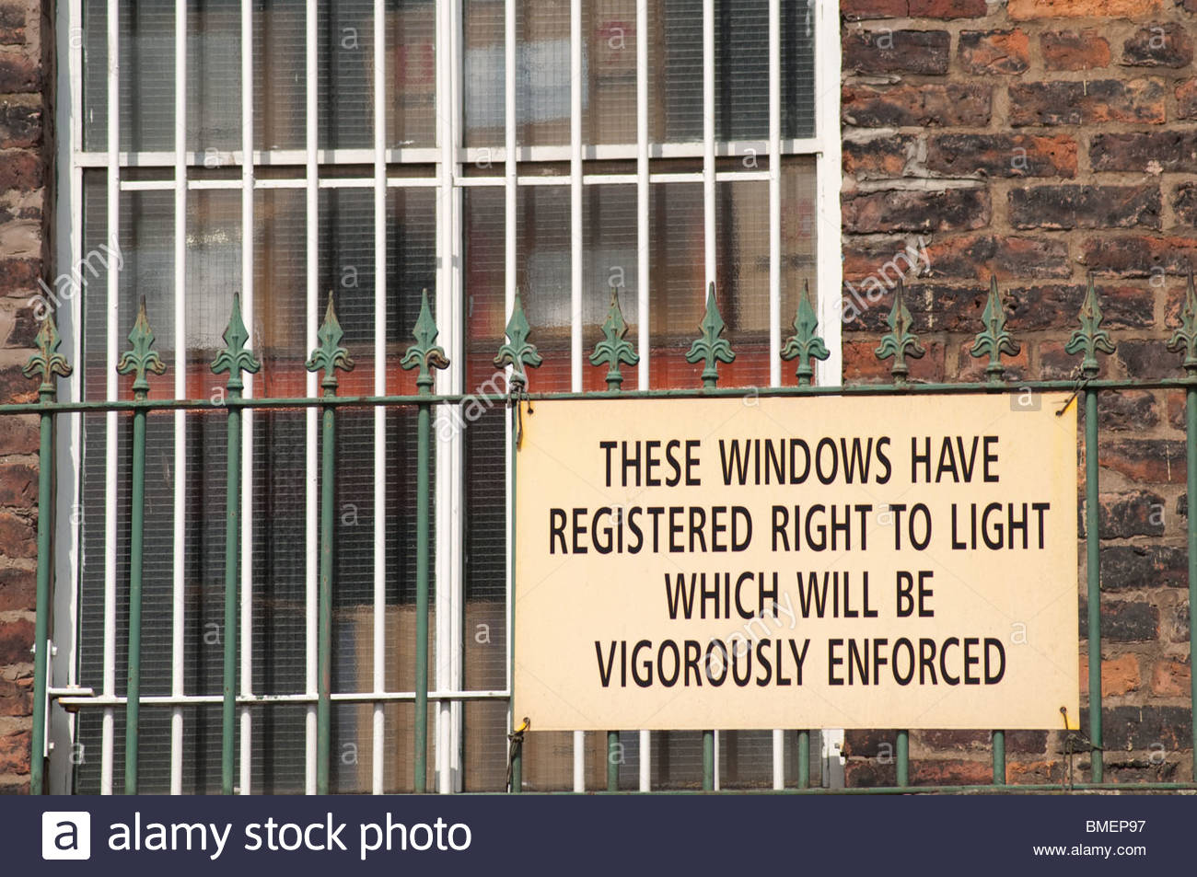

Slide 7


Slide 8
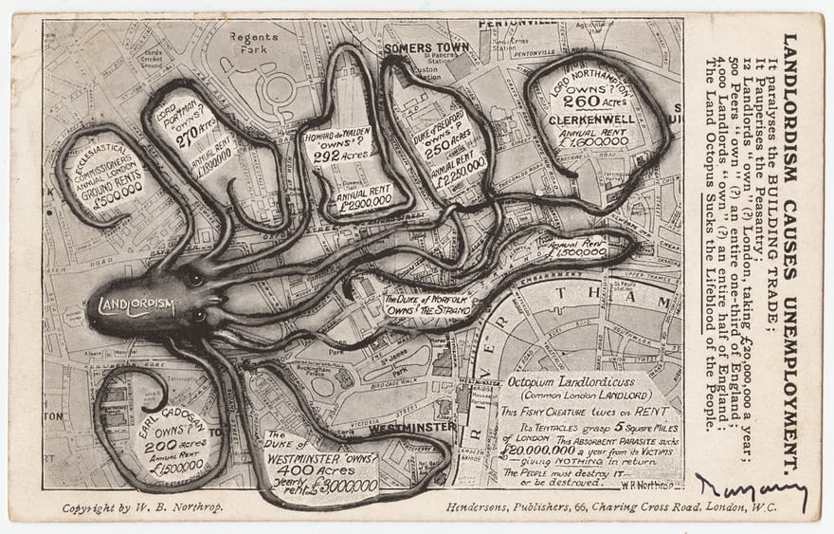
Notes:
WB Northrop’s 1925 polemic map shows the octopus of ‘Landlordism’ strangling London. Each of the beast’s tentacles surrounds an area of land said to be owned by the wealthy and powerful: Earl Cadogan, the Duke of Westminster, the Duke of Norfolk, Lord Northampton, the Duke of Bedford, Howard de Walden, Lord Portman and the ‘Ecclesiastical Commissioners’. Photograph: Cornell University/PJ Mode Collection of Persuasive Cartography

Slide 9


SQE
“Over the coming months we will work with solicitors, law firms, educators and students to develop a world-class assessment”.
Published June 2017
Many critiques but not many yet about the syllabus.

Slide 10
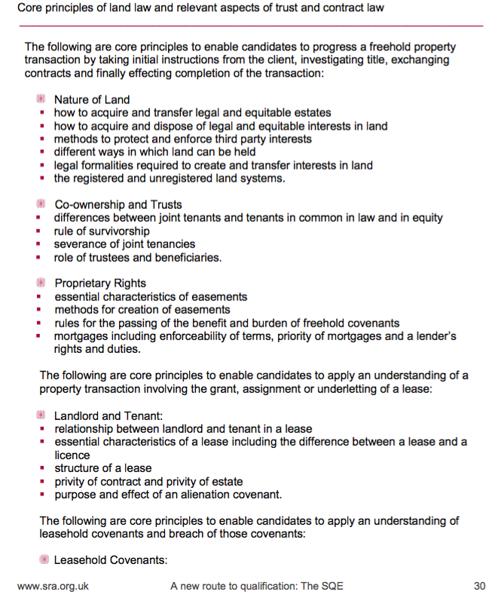
Notes:
And then …
Core knowledge areas of freehold real estate law and practice
Core knowledge areas of leasehold real estate law and practice
Core principles of planning law
Core principles of property taxation

Slide 11
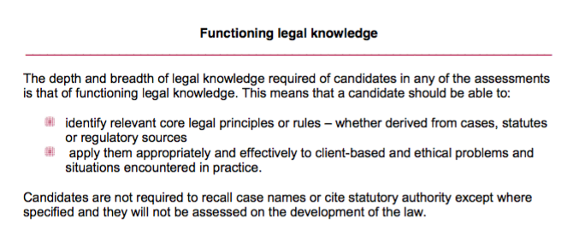
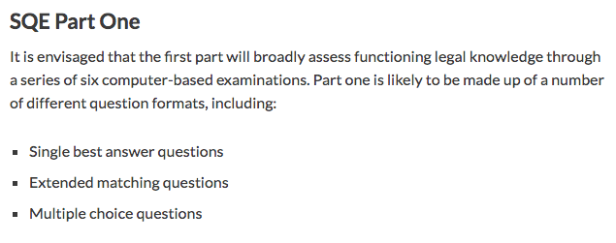

Slide 12
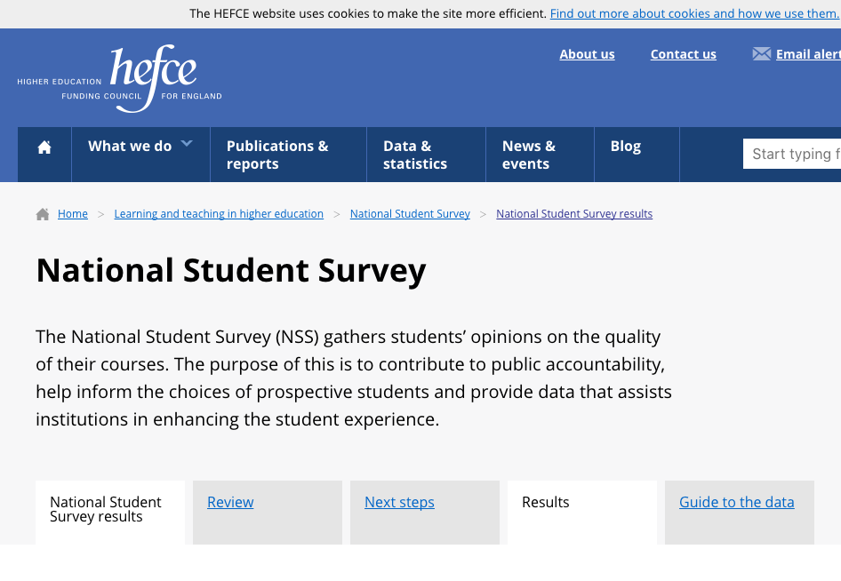
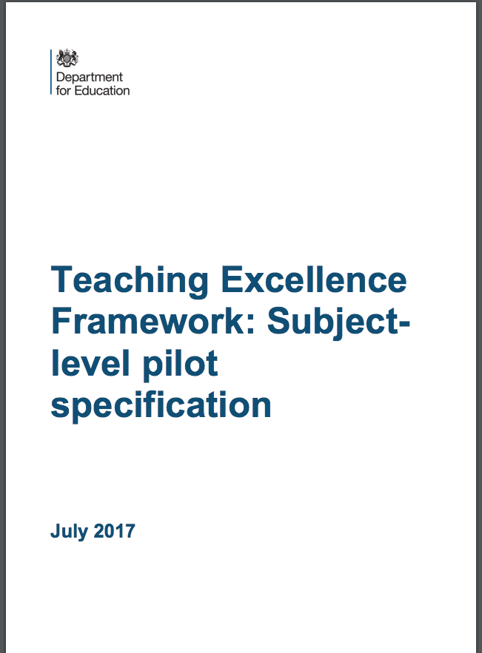
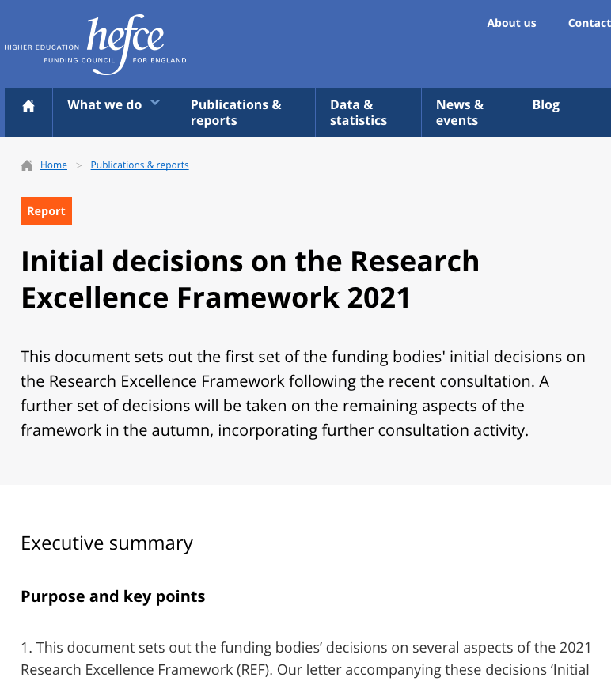
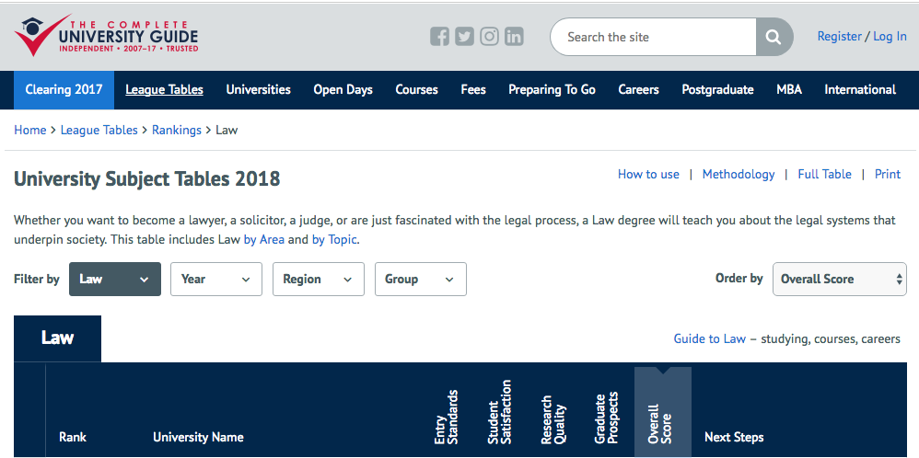

Law School Drivers

Slide 13
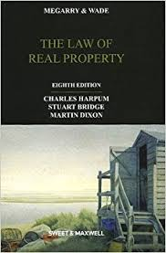
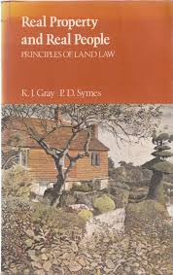
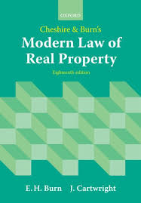

Slide 14
Stuart Anderson (1982 MLR vvol 45 346-352:
“Sadly it seems inevitable that this book’s obvious failure to present a coherent sociological or historical explanation of land law will strengthen the hands of those who argue that such an exercise has no place in legal study … Yet the materials are available for a proper historical account of modern land law, both in its politics and its economics. They can start to explain modern statute law, and also to show why different sorts of land dispute seem to w to come before the higher courts. Judical reaction is more dificult to explain, but at least a careful description based on all the evidence should be possible ...”.
Bernard Rudden (2 Oxford J. Legal Stud. 238, 244 (1982))
“It is true that, as regards the physical use of land-especially of housing-the law of property needs to be re-thought … But until some such regime is generally established we must face the fact that, whether we like it or not, the English law of property is a law of wealth. In dealing with things as objects of commerce, investment or endowment it is elegant and efficient, investing feudal terminology with mercantile content until the relation between the words used and their actual function is as remote as that between the spelling and the pronunciation of the English language”.

Slide 15
Conveyancing
Brian Harvey (reviewing a 2000 Edition of Megarry and Wade): “Writing for a dual market is always difficult. Students need the broad sweep; for practitioners the utility lies in the detail”.
“IT IS REALLY CONVEYANCING
For the academic lawyer, this is the taunt of “Philistine”. There are two parts of the argument: first, that the subject-matter of conveyancing is different and should be taught separately; secondly that teaching law as a practical or operational subject is something that should (or even must) logically come after the theory of the subject that has been mastered” (P.H. Kenny, Law Teacher, 1982 16(1) 23-28)

Slide 16
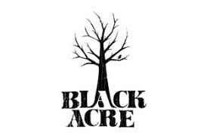
What is a land law syllabus?
“The set of general legal principles (and practices) that govern the relationship between citizen and land.”
Kate Green (“Land Law in 1985”): “This flaw is in the ‘splendid’ isolationism. Bereft of any context, real property law is accepted far too uncritically, for the study of land law without a study of its context means that students are not in control of the subject but that the subject is in control of them”.

Slide 17
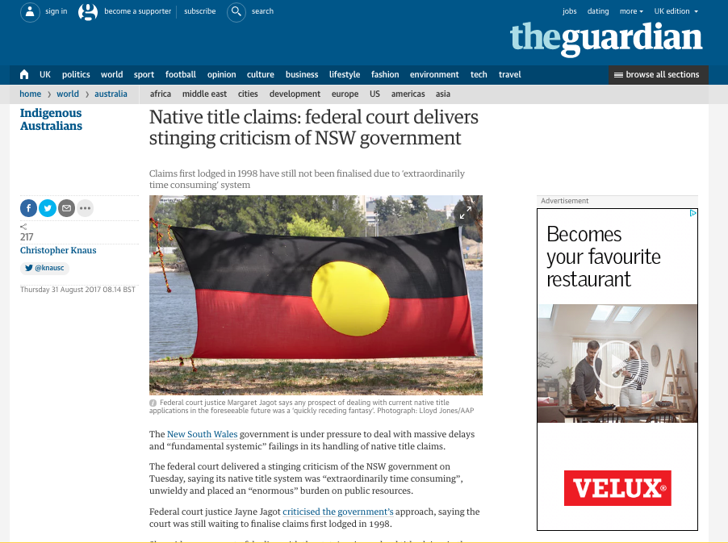

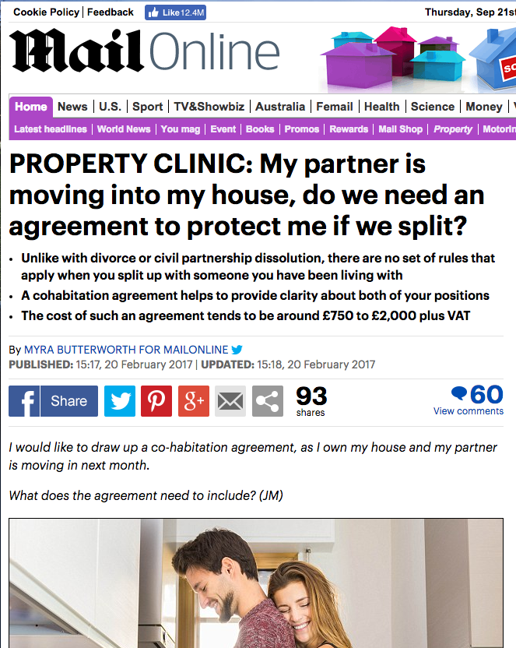


Slide 18
John Wylie NILQ Spring 1983 77-79:
“The authors’ explanation for their odd coverage seems to your reviewer to say so much about what is wrong with their book. Readers might as well have it verbatim: “The material covered is essentially the material contained in the syllabus of the Land Law I course taught at the University of Cambridge …
What, pray, are fellow land law teachers to make of that? Doubtless few of us would deny the right of the Cambridge teachers to provide strictly “in house” material for their own students, but to present the rest of us with a text on the same basis is as breathtaking in its arrogance as it is offensive. The authors do not even attempt to make it palatable by the remotest of suggestions as to why we should accept the Cambridge syllabus as the idea.. This sort of nonsense reflects no credit at all on either the authors or the publishers”.

Slide 19
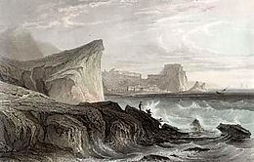
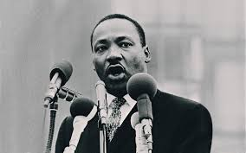
“The function of education is to teach one to think intensively and to think critically. Intelligence plus character - that is the goal of true education.”

