Slide 1
'T ain't what you do it's the way that you do it - That's what gets results (Ella Fitzgerald, written by Melvin Oliver and James Young)
Graham Ferris

Slide 2
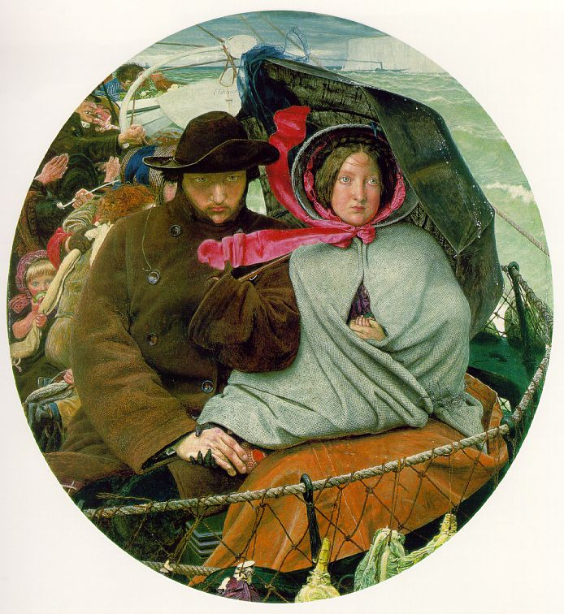

Slide 3
Prologue: Foreground, middle-ground, and background
The Last of England by Ford Madox Brown, 1855. Oil on panel. Original in the Birmingham Museums and Art Gallery
Foreground: SQE
Middle-ground: jobs, costs, technological change, and Brexit
Background: cognitive, emotional, and cultural preparedness of students for Higher Education

Slide 4
Some Assumptions I make but will not defend
Land law taught as a crammer for the SQE part one (or two) would be a bad outcome.
Development of land law (property law) should be driven by the professionals who teach law (legal academics), and
Primary responsibility for either developing or implementing development in land law should be on the legal academics who teach land law
2 & 3 reflect my understanding of educative practice, learning, and the reproduction of a discipline (see: Shulman, Lave & Wenger, Sahlberg)

Slide 5
Some Assumptions I make but will not defend
4. Law teaching should self-consciously engage with values touching the law being taught.
5. Law teaching should be designed and delivered with an assumption of the correctness of a pluralistic understanding of values.
These two proposition I have explored at length in The Uses of Values in Legal Education
Obviously, if I hold to these propositions it is not my place to hold out solutions for others to adopt. As with research the task is to frame the question or problem in a manner that enables intelligence to be applied in a productive manner.

Slide 6
The Argument
There is no realistic possibility of teaching all that would be required for a full and complete understanding of property law
Therefore, selection of material must be made upon a basis of criteria not internal to property law
If I am correct here the consequence is we select in ways that are defensible in non-property terms – we select property law that serves other non-property law educational ends (because we cannot justify any selection on exclusively property law terms).

Slide 7
A Trivial but Familiar example (analogy)
I wish to travel in order to experience the full range of natural and human diversity that I can safely experience (no war zones).
I cannot travel everywhere now (or at all).
There is no criteria that ranks types of diversity as a good.
Therefore, I will plan my travel upon external criteria (e.g. cost, word of mouth recommendation, comfort, my interests).
I do travel to unfamiliar places, but I do chose my destinations according to criteria other than my basic reason for traveling which is found in an interest in difference (physical and human).

Slide 8
Why we cannot teach everything
Property law includes land law.
Property law is necessarily complex because property rights affect strangers to property transactions. Land law is more complex because land endures through time.
Property law is important because access to and control of property facilitates life chances, lack of effective claims to property obstructs life chances. Land law is important because everyone must be somewhere, and activities upon land affect the environment of both close and distant neighbours.
Property law is taught because it is foundational to transactional law, the ability of parties to plan for the future, and the rule of law. Land law is taught because of the historical role it had in the development of the common law, and in practice.
Property law is foundational of capitalist economies. Land law is a foundational for a massive contemporary market in interests in land.

Slide 9
How to Select? From the perspective of the learner as constrained by the discipline
We cannot teach everything that one could benefit from learning.
We select for coherence of the subject matter remaining true to the inherent demands of the subject and discipline.
We select for cognitive/technical capacity development of the learner through inculcation of the skills and abilities central to the discipline.
We select for identity/emotional/ethical development of the learner through exploration of values in the law.

Slide 10
How to Select: Development of each learner
Ideally: one should offer the learner an experience which does not frustrate by being beyond her competence nor bore her by being too easy, it should be pitched at the outer edge of her existing competence (Vygotsky – zone of proximal development - scaffolding)
BUT
learners have different capacities
THEREFORE
Teach multi-faceted material with multiple learning objectives, only some of which are required for successful study per assessment.

Slide 11
Example
Hammersmith and Fulham LBC v Monk [1992] 1 AC 478 is about the nature of the periodic lease.
It is a fine example of a true ethical dilemma as recognised by Lord Browne-Wilkinson one could protect the reasonable expectations and property interest of one joint tenant only at the cost of holding the other joint tenant of an obligation (and relationship) no longer desired.
It is an example of a justice problem – the current law permits the destruction of the property of one joint tenant by the inaction of the other joint tenant, without compensation or recourse at law. At an accidental level (as the facts are usually arranged) the losing joint tenant has behaved badly. There is nothing in the law to require this be the case.
It is an example of legal fiction in modern law.
It is an example of the tension between Human Rights jurisprudence and the common law of property.
It is an example of the confusion caused when the law uses the same word (tenancy) to describe two different legal institutions (the joint tenancy is of a periodic tenancy and the two uses of the word tenancy are technical legal words with different meanings).
Therefore, one can teach the one case for more than one purpose, and catch the edge of competence zone for many learners.
I think the use of one word for two things is the easiest issue to catch – so that would be the pass understanding; to explain the problem one needs to be able to describe the two concepts of joint tenancy and periodic tenancy.
I think the ethical dilemma is very interesting, as it requires the learner to accept that the lesser of two evils may be the most that the law can aspire to. There is no fully satisfactory solution. However, it is a lot more difficult to fully understand than the “one word for two things is confusing” point.

Slide 12
How to Select? Giving the learner access to the fundamental principles at play in property law
Ideally: the material should explore the same difficult concepts several times starting with simple to apprehend examples and adding complexity upon repetition (sometimes known as the Bruner spiral, but could be derived from Whitehead on the Rhythm of Education)
BUT
Mere repetition is boring, and simple examples in land law are rare
THEREFORE
Teach land law as property law in order to make simpler examples available

Slide 13
Example
Relative title is a difficult concept but it may be thought an important one for understanding how the common-law of property developed and for understanding the nature of property.
Use the finding cases (Armory v Delamirie etc) to introduce the concept of relative title, then teach (e.g.) claims based on adverse possession over land (which like Monk has a myriad of possible directions for exploration).
Generally, title to goods is both simpler (less claims extant) and easier for students to grasp (more familiar).

Slide 14
How to select: with a view to student reflection upon values
Ideally: study of the law should facilitate student reflection upon values (both personal and systemic) and conflicts between values. This both serves the disciplinary aim: of appreciating the normative nature of law; and the individual learner aim: of selection and adoption of values by the developing learner.
BUT
The content of law is hard enough for students to learn, and as educational practitioners we should not proselytise.
THEREFORE
Use the resolution (or failure to resolve) value conflicts in land law in teaching, and teach the underlying value conflicts expressly.

Slide 15
Example (of a failure to find a satisfactory resolution)
What are Stack v Dowden and Jones v Kernott about?
Is it a principle of fairness used to determine imperfectly arranged property claims?
Is it a principle of consistency in dealing with post-relationship claims within and outside of marriage?
Is it legal recognition of the need for a distinction in law between residential ownership and other ownership of property (is it a principle that the nature of a home demands different and more discretionary legal treatment after Fox)
Is it an extreme example of the recognition of the lesser need for certainty for property claims between owners than for property claims between owners and third parties?
Is it mainstream property law – and what would that mean? Just what intuitions of property lawyers are violated and why should the law avoid the same?

Slide 16
References
Jerome S Bruner, In Search of Pedagogy Volume 1 (Routledge 2006)
Graham Ferris, Uses of Values in Legal Education (Intersentia 2015)
Lorna Fox, Conceptualising Home: Theories, Law and Policies (Hart Publishing 2007)
Jean Lave & Etienne Wenger, Situated Learning: Legitimate Peripheral Participation (Cambridge University Press 1991)
Pasi Sahlberg, Finnish Lessons 2.0: What Can the World Learn from Educational Change in Finland? (Teachers College Press 2014)
Lee S Shulman, Teaching as Community Property: Essays on higher Education (Jossey-Bass 2004)
L S Vygotsky, Mind in society: The development of higher psychological processes (Harvard University Press 1978).
Alfred North Whitehead, The Aims of Education (Free Press 1967)

