Slide 1
Introducing the Virtual Land Law Field Trip Project
Dr Verona Ní Drisceoil, Lecturer in Law

Slide 2
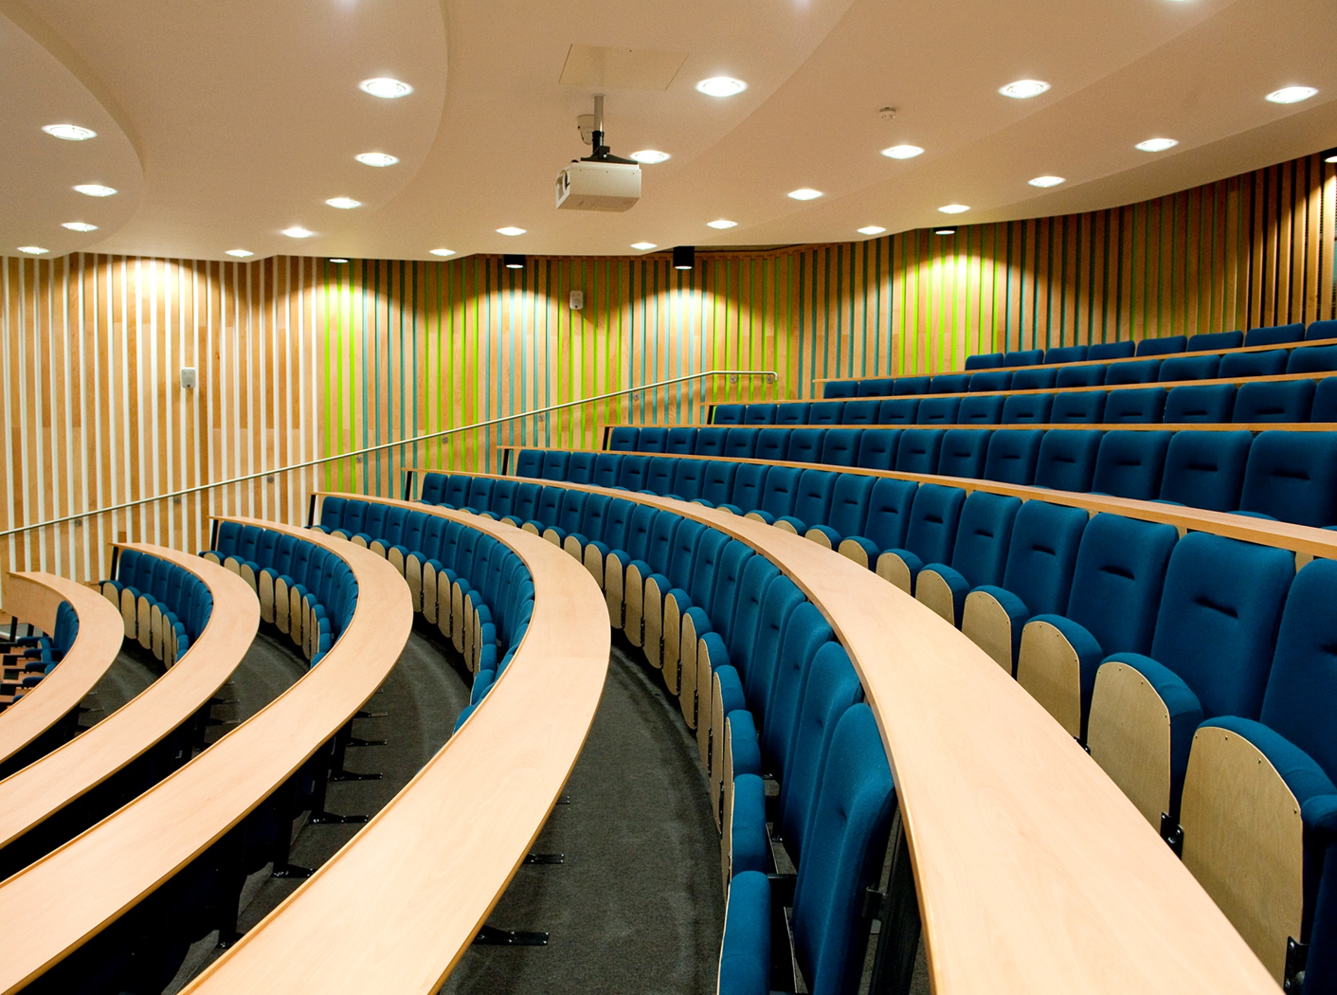
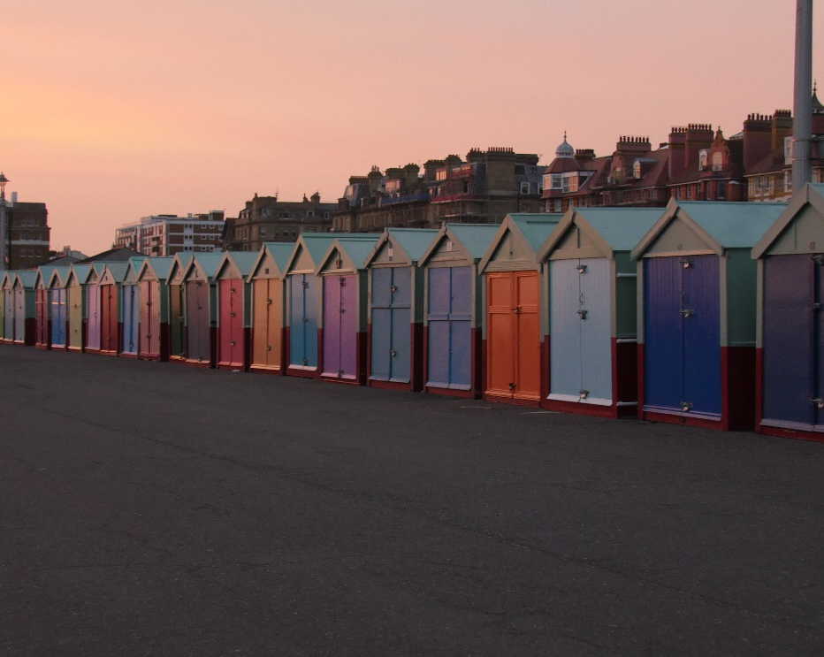
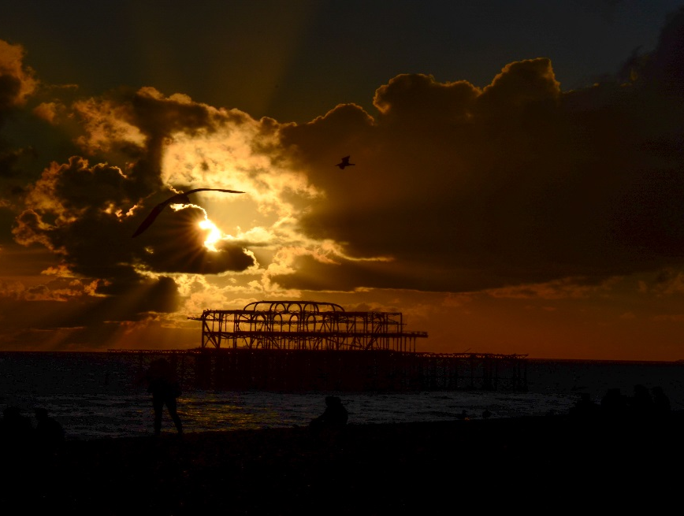
The concept

Slide 3
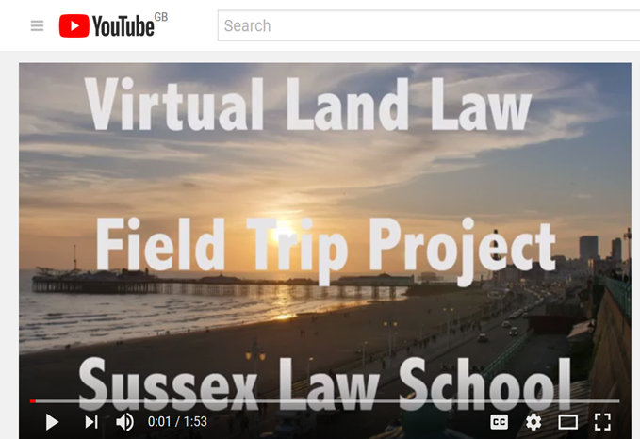
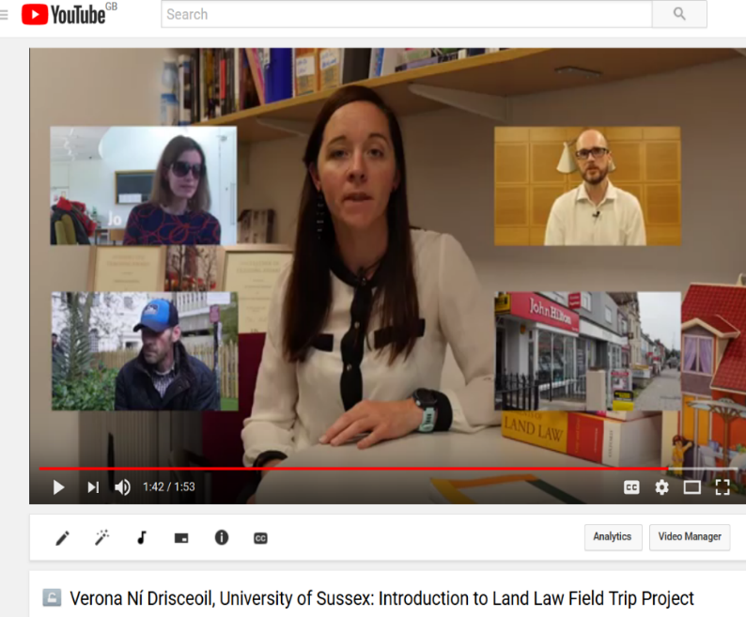
The videos
In essence, the Virtual Land Law Project is a series of bespoke land law videos that have been produced to run alongside the teaching of the land law module at the University of Sussex. The project does not seek to replace the core substantive teaching of the module but rather offers a means within which to enhance and enrich, and give added value (I hope!).
The videos are ‘Brighton based’ and represent different perspectives and voices (on homelessness, access, the housing crisis, advising clients) and thereby offer a unique and visual opportunity and platform within which students can engage with challenging issues and topics within the land law curriculum.

Slide 4
The Videos
Videos:
Video 1: An Introduction to the Project (Verona) https://youtu.be/yiOqkmS5OLg
Video 2: The Geographer’s Perspective (Geoffrey Mead) https://youtu.be/YAu38tGysuY
Video 3: Grenfell Tower –the legal issues (David Smith)
Video 4: Advising clients (David Smith)
Video 5: Student Housing (Dean) (Dean Spears)
Video 6: Brighton Housing Trust I (Nigel Parkinson)
Video 7: The Housing Crisis (Nigel Parkinson)
Video 8: Paul’s story (Paul)
Video 9: David Smith on McDonald v McDonald (David Smith)
Video 10: David Smith on becoming a solicitor/legal practitioner (David Smith)
To be edited:
Video 11: Nothing for us without us (Dan, Jo & Jean)
Video 12: StreetLaw project (Students)

Slide 5
How the project will work?
The bespoke videos have now been added to our e-learning platform, Study Direct.
The videos will be (Autumn Term 2017) used in lectures, seminars and for independent viewing by students.
To reiterate, they are not intended to replace but rather to add value.
Assessment
The videos capture, in broad terms, social justice issues and there will be an opportunity in Assessment Block 1 (Jan 2018) to submit an essay on issues raised in/by the videos. Students will also have the option of completing an essay or problem question of a more traditional format.

Slide 6
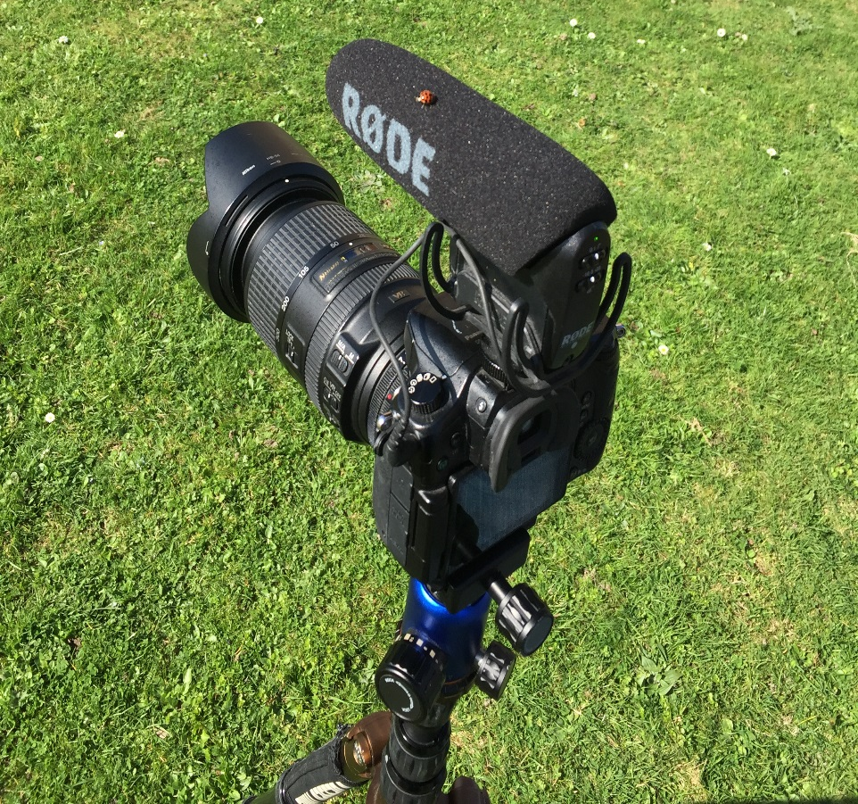
The challenges
Challenges:
Resources were limited - Innovation in Teaching Award = £5000.00.
Time, effort, admin (all in my ‘own’ time).
Editing process and working with LLM students.
What I could have done better?
More diversity in the videos. They are not very diverse thereby running counter to one of the key messages!

Slide 7
Thank you!

