Slide 1
There is Life in Black Letter Land Law Yet
Professor Warren Barr, PFHEA
T: @academicbarzo

Slide 2
Overview
Student Issues with Land Law
Changing Delivery to Meet the Application Gap
The Liverpool Context & ‘Teach Smarter’
Land Law: Improving Performance
What’s in a Name?
From Land Law II to Commercial Real Property

Slide 3
STUDENT ISSUES WITH LAND LAW
Notes:
Think Land is one of the most connected subjects already (challenge is to make UG students see it) – does not need to be reconceptualised. Rules and regulations which people need to be proficient in applying to everyday situations – big challenge is application, not knowledge for students and fact that, as technical, there is the horrifying possibility that an answer can be fundamentally and categorically wrong.

Slide 4
Land at Liverpool
Year of Study
Moved from Final Year to Second Year (up and down)
Equity & Trusts (30 credits) includes family homes
Land and Equity now taught together in Year 2
Syllabus
15 credit subject
Very spare syllabus (estates, recognising third party rights, registration, co-ownership, trusts of land)
Additional optional module
15 credits (Final Year)
Covered mortgages, easements, commercial landlord and tenant

Slide 5
Student Issues
Student Fears
Technical - can be wrong
Hard to engage with real life significance
Diagnosis
’Partly Intuition, Partly Inference’
Application was the issue
Reflection on years of good tutorial performance, poor assessment performance
Data collection
Reflecting on attainment trends, compared to other subjects
Focus groups with students

Slide 6
CHANGING DELIVERY TO MEET THE APPLICATION GAP

Slide 7
‘Teach Smarter’: Curricula Review (2006)
Importance of Engagement
Better engaged students achieve their potential
Many different styles of learning can facilitate engagement
Focus for good module design
Improving Learning Experience
Emphasis on student engagement
Structured learning – pre- and post- delivery engagement
Improving feedback & assessment methods
Teaching Smarter, Not More
Less repeat teaching for staff
More engaging delivery for staff and students
Better experience overall
Notes:
Process I lead as what is now called ‘Director of Education’

Slide 8
Land Law: The Original Module
15 credit module (‘short, thin’)
24 lectures + 5 tutorials for 250+ students
Repeat Teaching
Groups of 10 students = 25 tutorial groups
Delivery Hours: 125 per Semester
Standard, Didactic Lectures
Tutorial Preparation:
Students Conduct Individual Preparation and Participate In Interaction With The Tutor
Feedback: One Piece of Formative Written Work
Assessment: 100% unseen examination (3 questions in 2hrs 15 mins)

Slide 9
Land Law: The Revised Module
15 credit module (‘short, thin’)
24 lectures for 250+ students
10 x 50 min ‘drop in’ sessions
Replace tutorials/seminars
Voluntary – structured Q&A round topics (8)
Skills audit (1) and Revision Q&A (1)
3 formative essays per student
On major substantive issues – mixture of essay and problem questions
Feedback
Individual and Collective Feedback on Each Formative Essay
Online Skills exercise feedback
MCQ feedback
Assessment: 95% unseen examination (2 questions in 1hr 30 mins) + 2 MCQ tests (each worth 2.5% each)

Slide 10
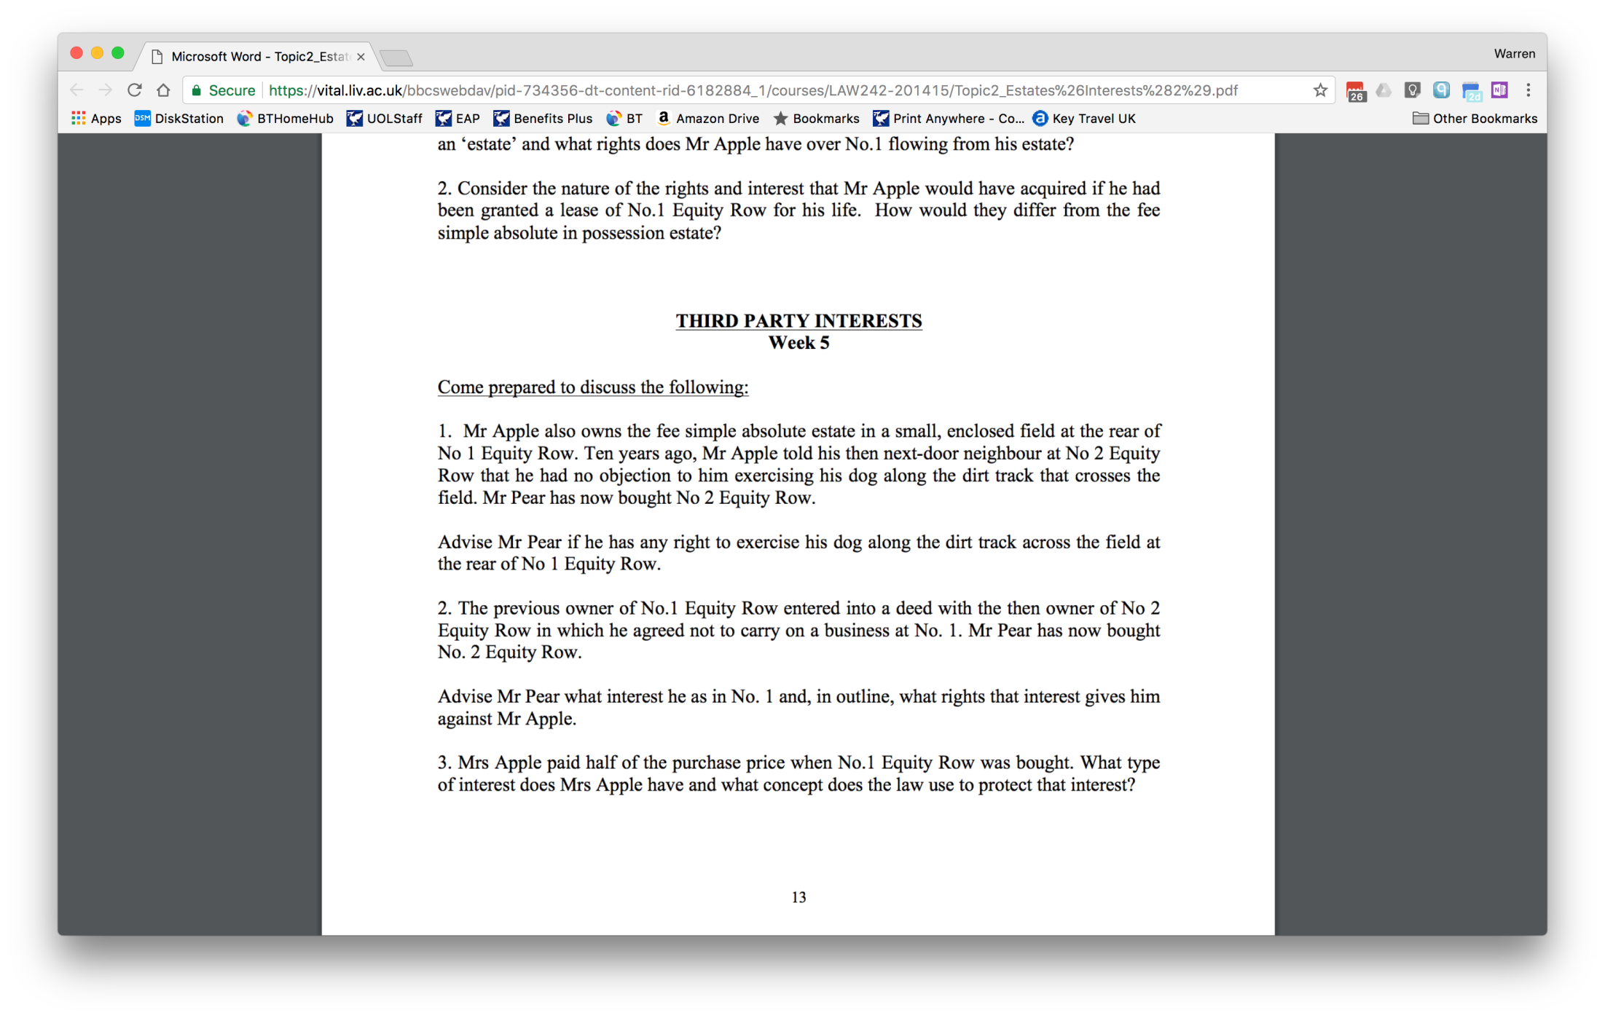
Notes:
Example – Drop in Session (smaller chunks)

Slide 11
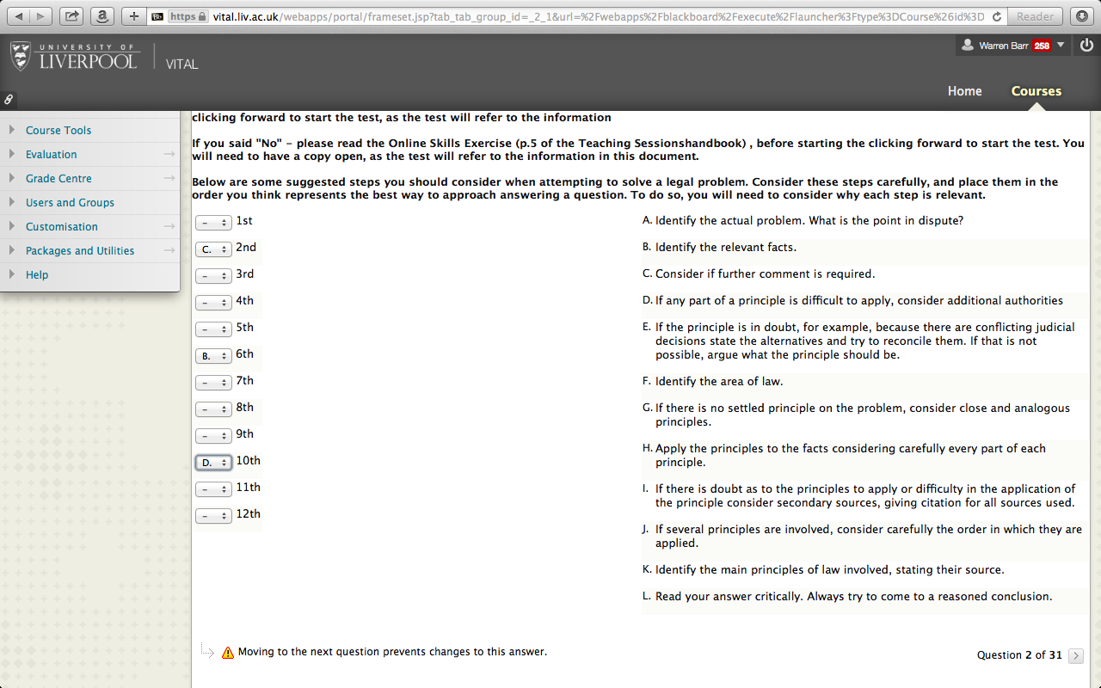
Notes:
MCQ – Skills Audit

Slide 12
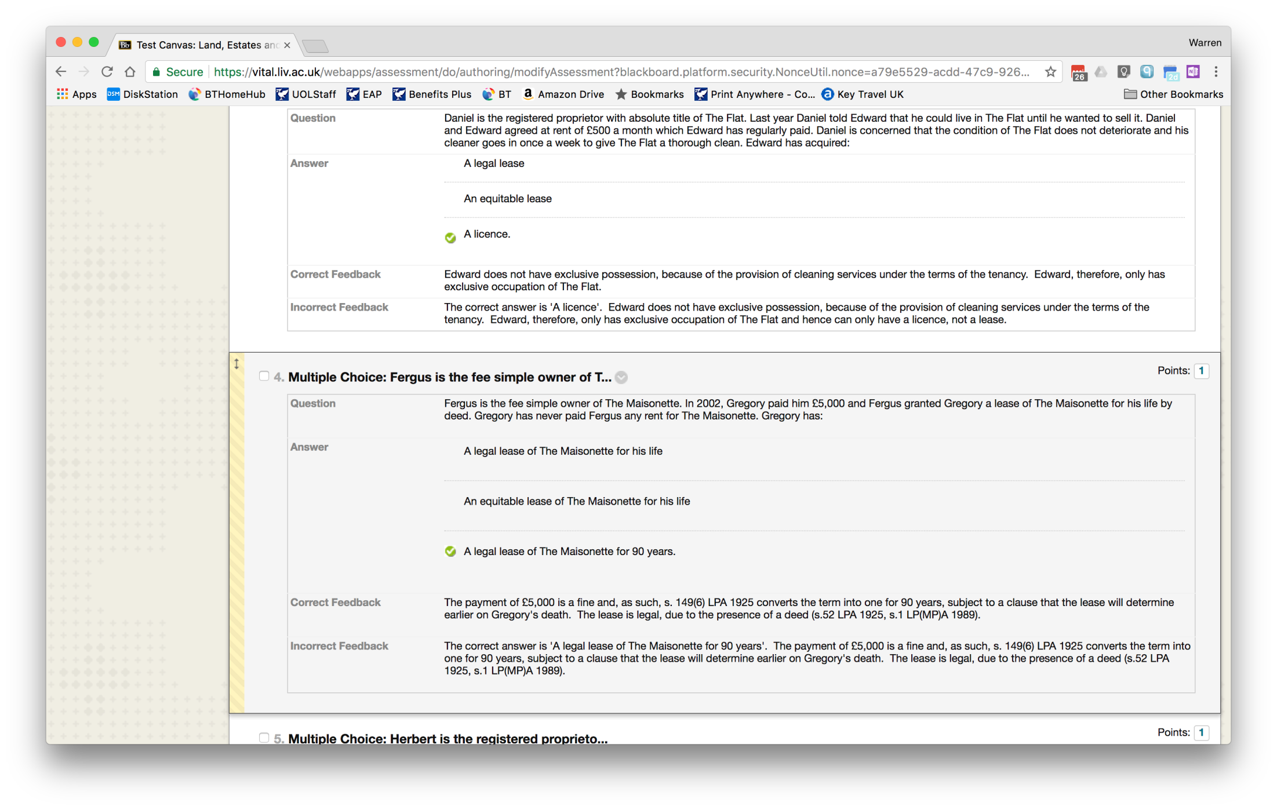
Notes:
MCQ Test – Estates and Interests (get 5 out of 10 correct)

Slide 13
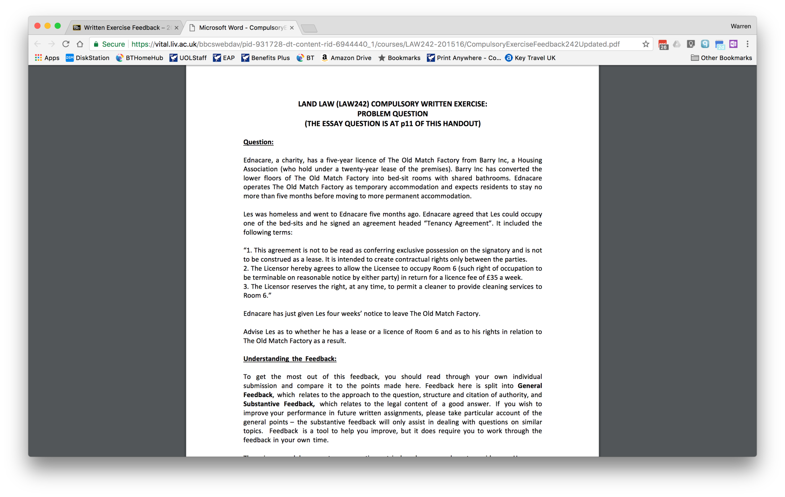
Notes:
Example of Feedback for Written Work

Slide 14
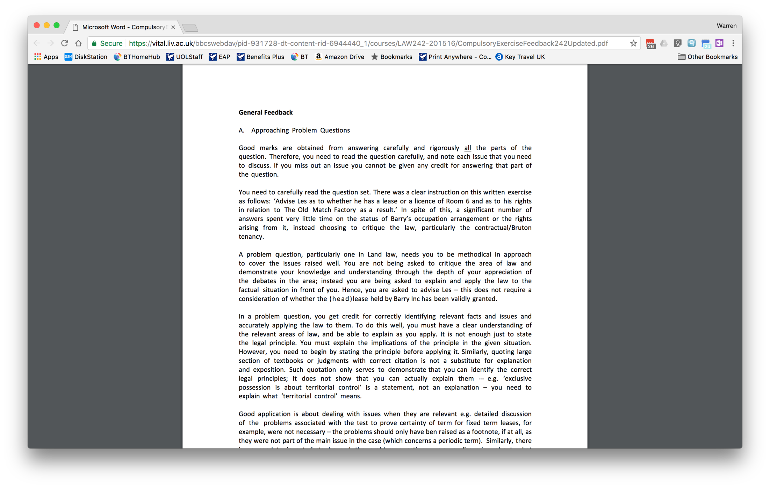
Notes:
Generic (Feed Forward)

Slide 15
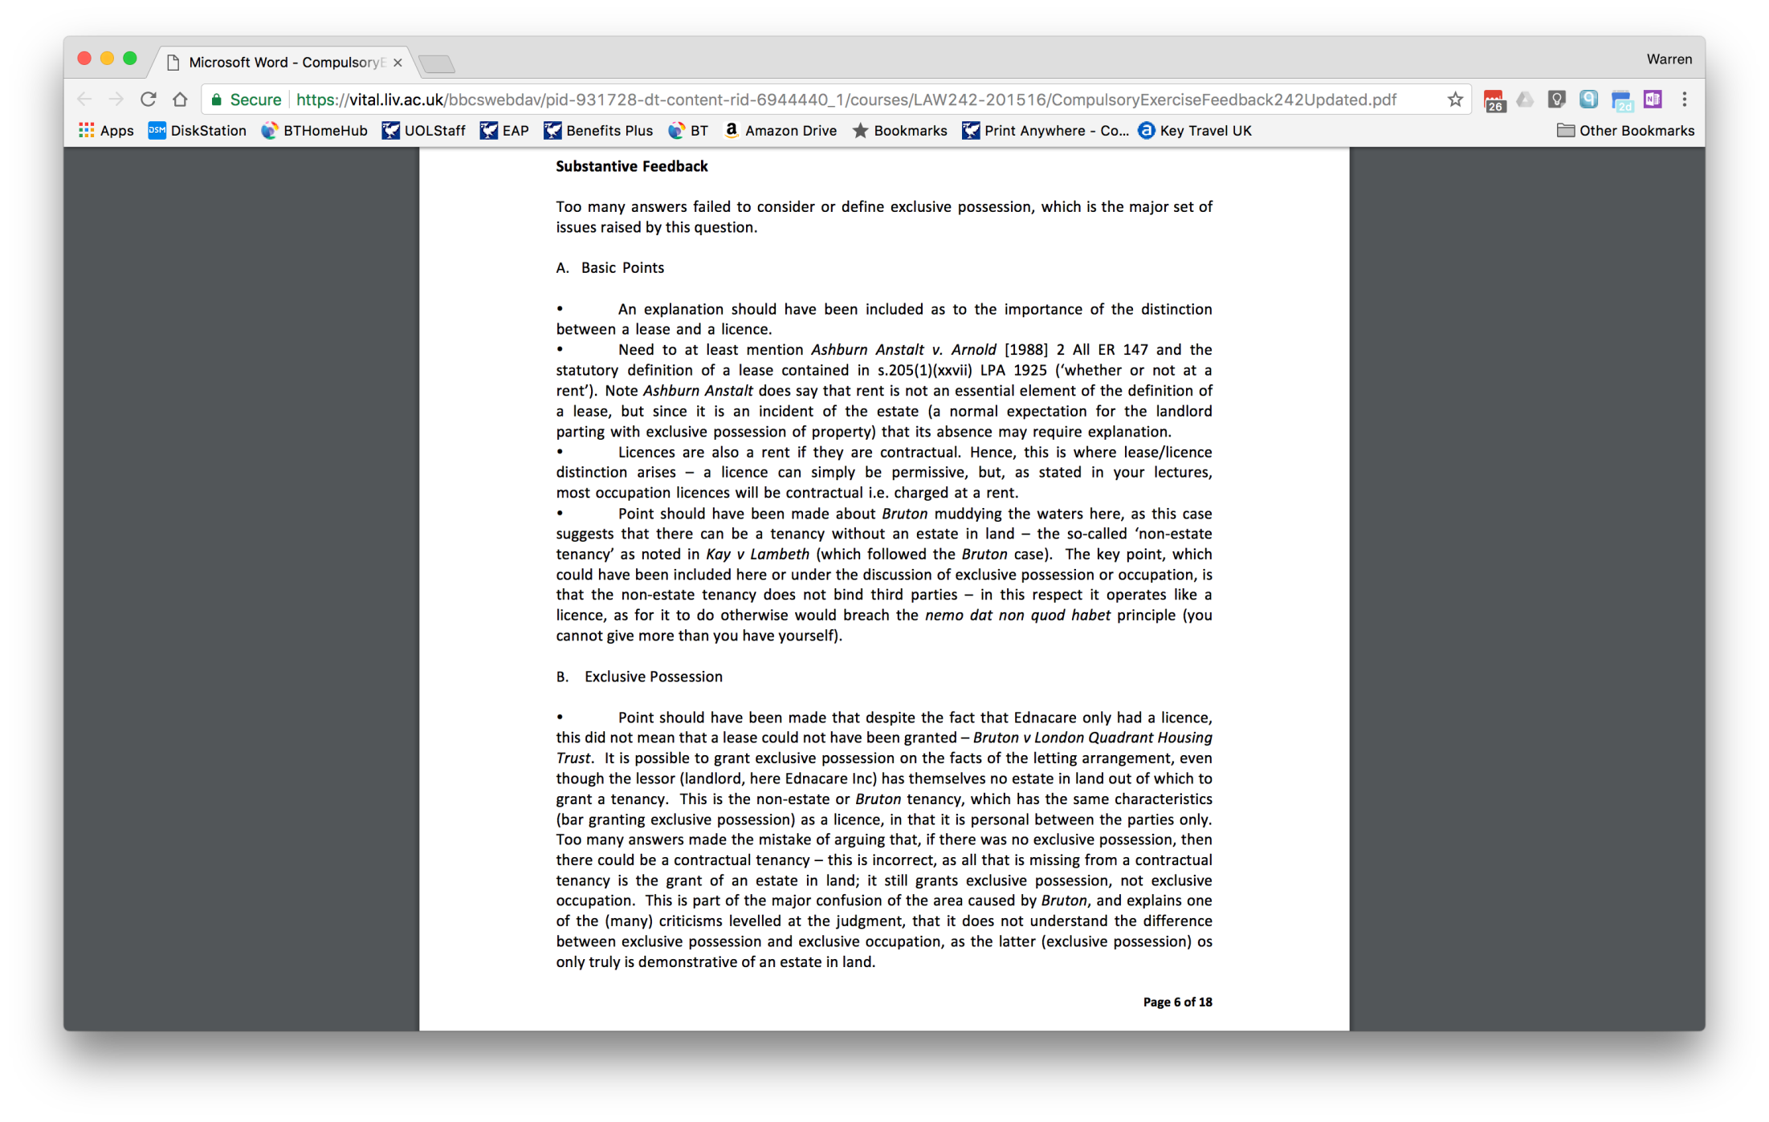
Notes:
Substantive (Detailed Feedback on the issues)

Slide 16
Peer Review To Engage Students
First Formative Piece of Written Work
Written Work Marked By Staff
Examples Selected and Rendered Anonymous
10 Examples (across classes) given to students with instructions and detailed feedback re: content of answer
Student marked own work and gave mark, with reasons, to staff
Staff released actual mark awarded
Feedback session to consider the whole process

Slide 17
Impact on Attainment
Better Student Engagement
5% MCQ required submission of all written work
Very few students failed to submit
Profile of Land Law Changed
Student Engagement Much Better
Majority of marks in First Class and Upper Second Category
e.g. 24% First Class, 46% Upper Second (2016-17)
Small Tail of Failing Marks
42% improvement in attainment over previous delivery method

Slide 18
WHAt’s In A NAME?
LAND LAW II TO COMMERCIAL REAL PROPERTY

Slide 19
The Original Land Law II
Land Law II
Covered:
Nature of leases
Content of leases (covenants)
Transmission of leasehold covenants
Landlord and Tenant Act 1954, Part II
Mortgages
Easements
Lectures, Tutorials and Unseen Exam
Student Attainment was weak
Few Firsts or Fails, but Large Mid section in 2.2/bare

Slide 20
The Revised: Commercial Real Property
Commercial Real Property
Covered:
Nature of leases
Content of leases (covenants)
Transmission of leasehold covenants
Landlord and Tenant Act 1954, Part II
Commercial Significance of Mortgages & Easements
Lectures, Bi-weekly 2 hour seminars (with student presentation), coursework
Coursework had a ‘novel’ structure to test application
Impact
Numbers rose from circa 20 a year to circa 80
Attainment – on a par with any other final year module

Slide 21
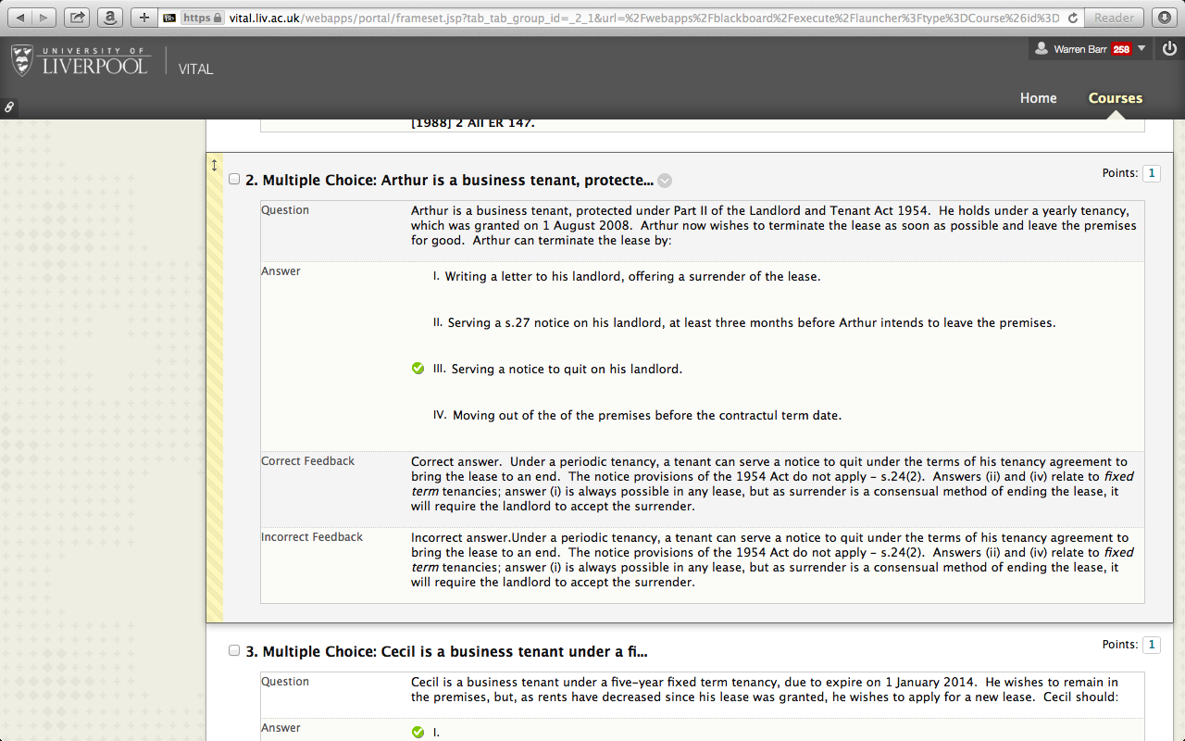
Notes:
MCQ tests – to support learning

Slide 22
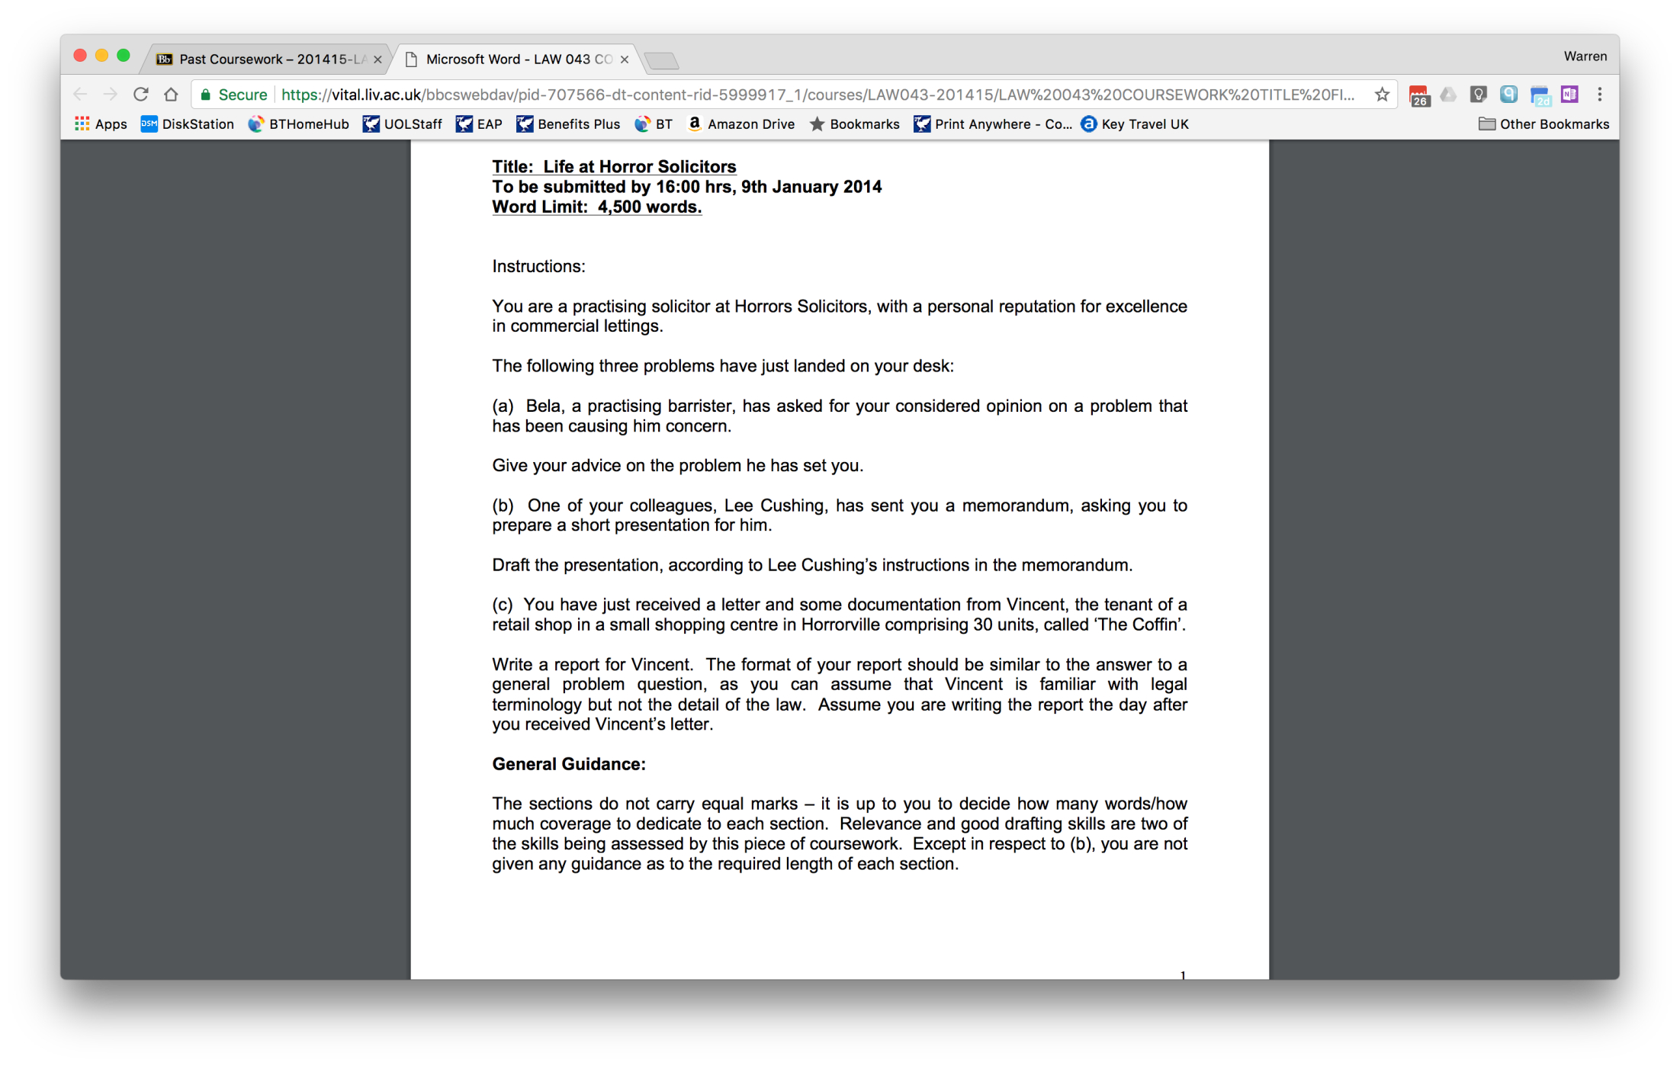
Notes:
Coursework – real world problem

Slide 23
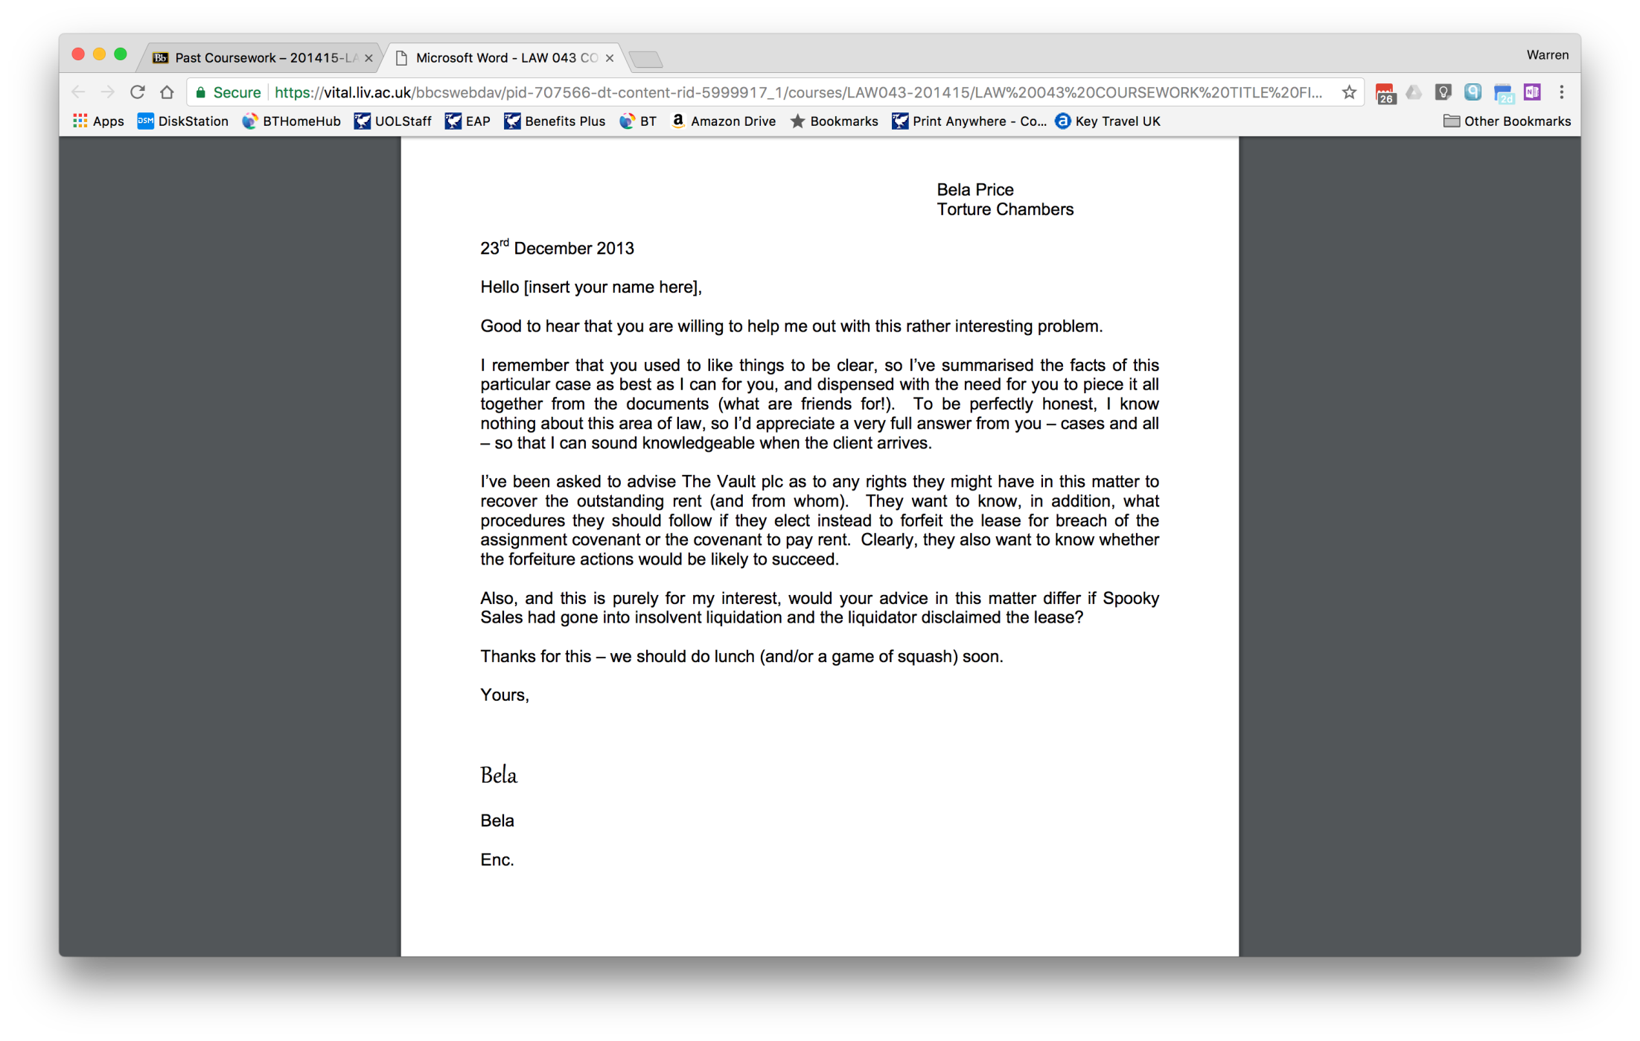
Notes:
Standard problem Q (dressed up)

Slide 24
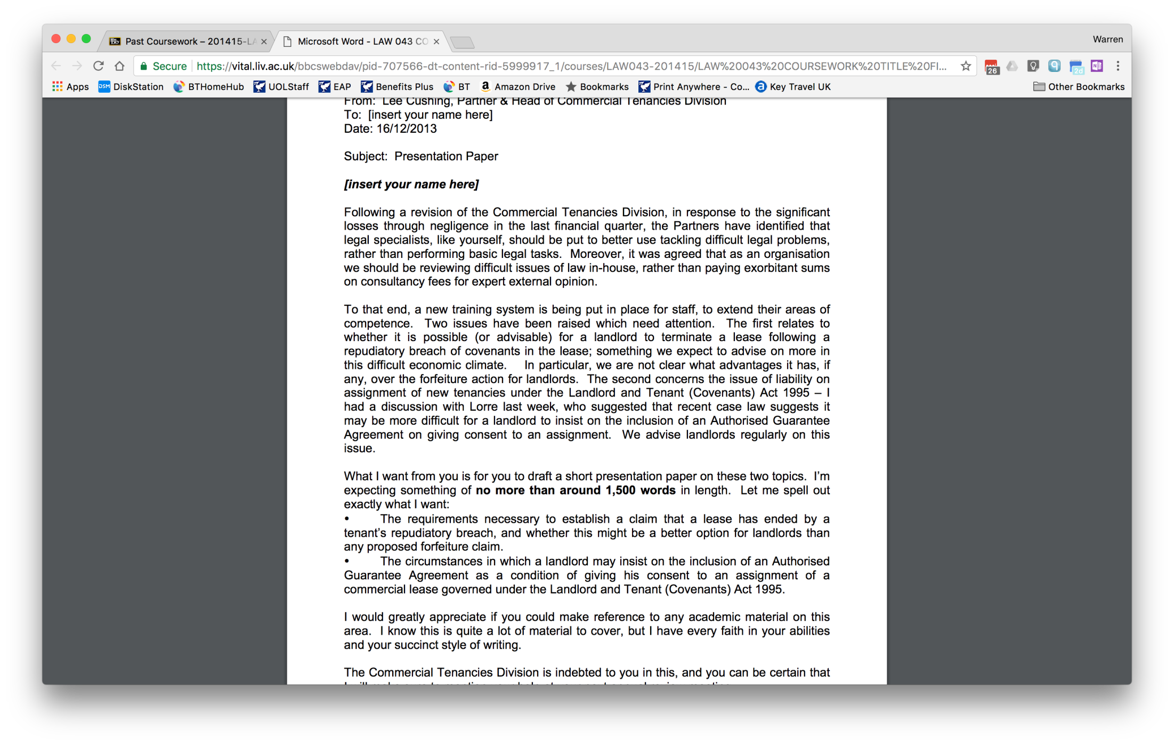
Notes:
Presentation (writing for a target audience)

Slide 25
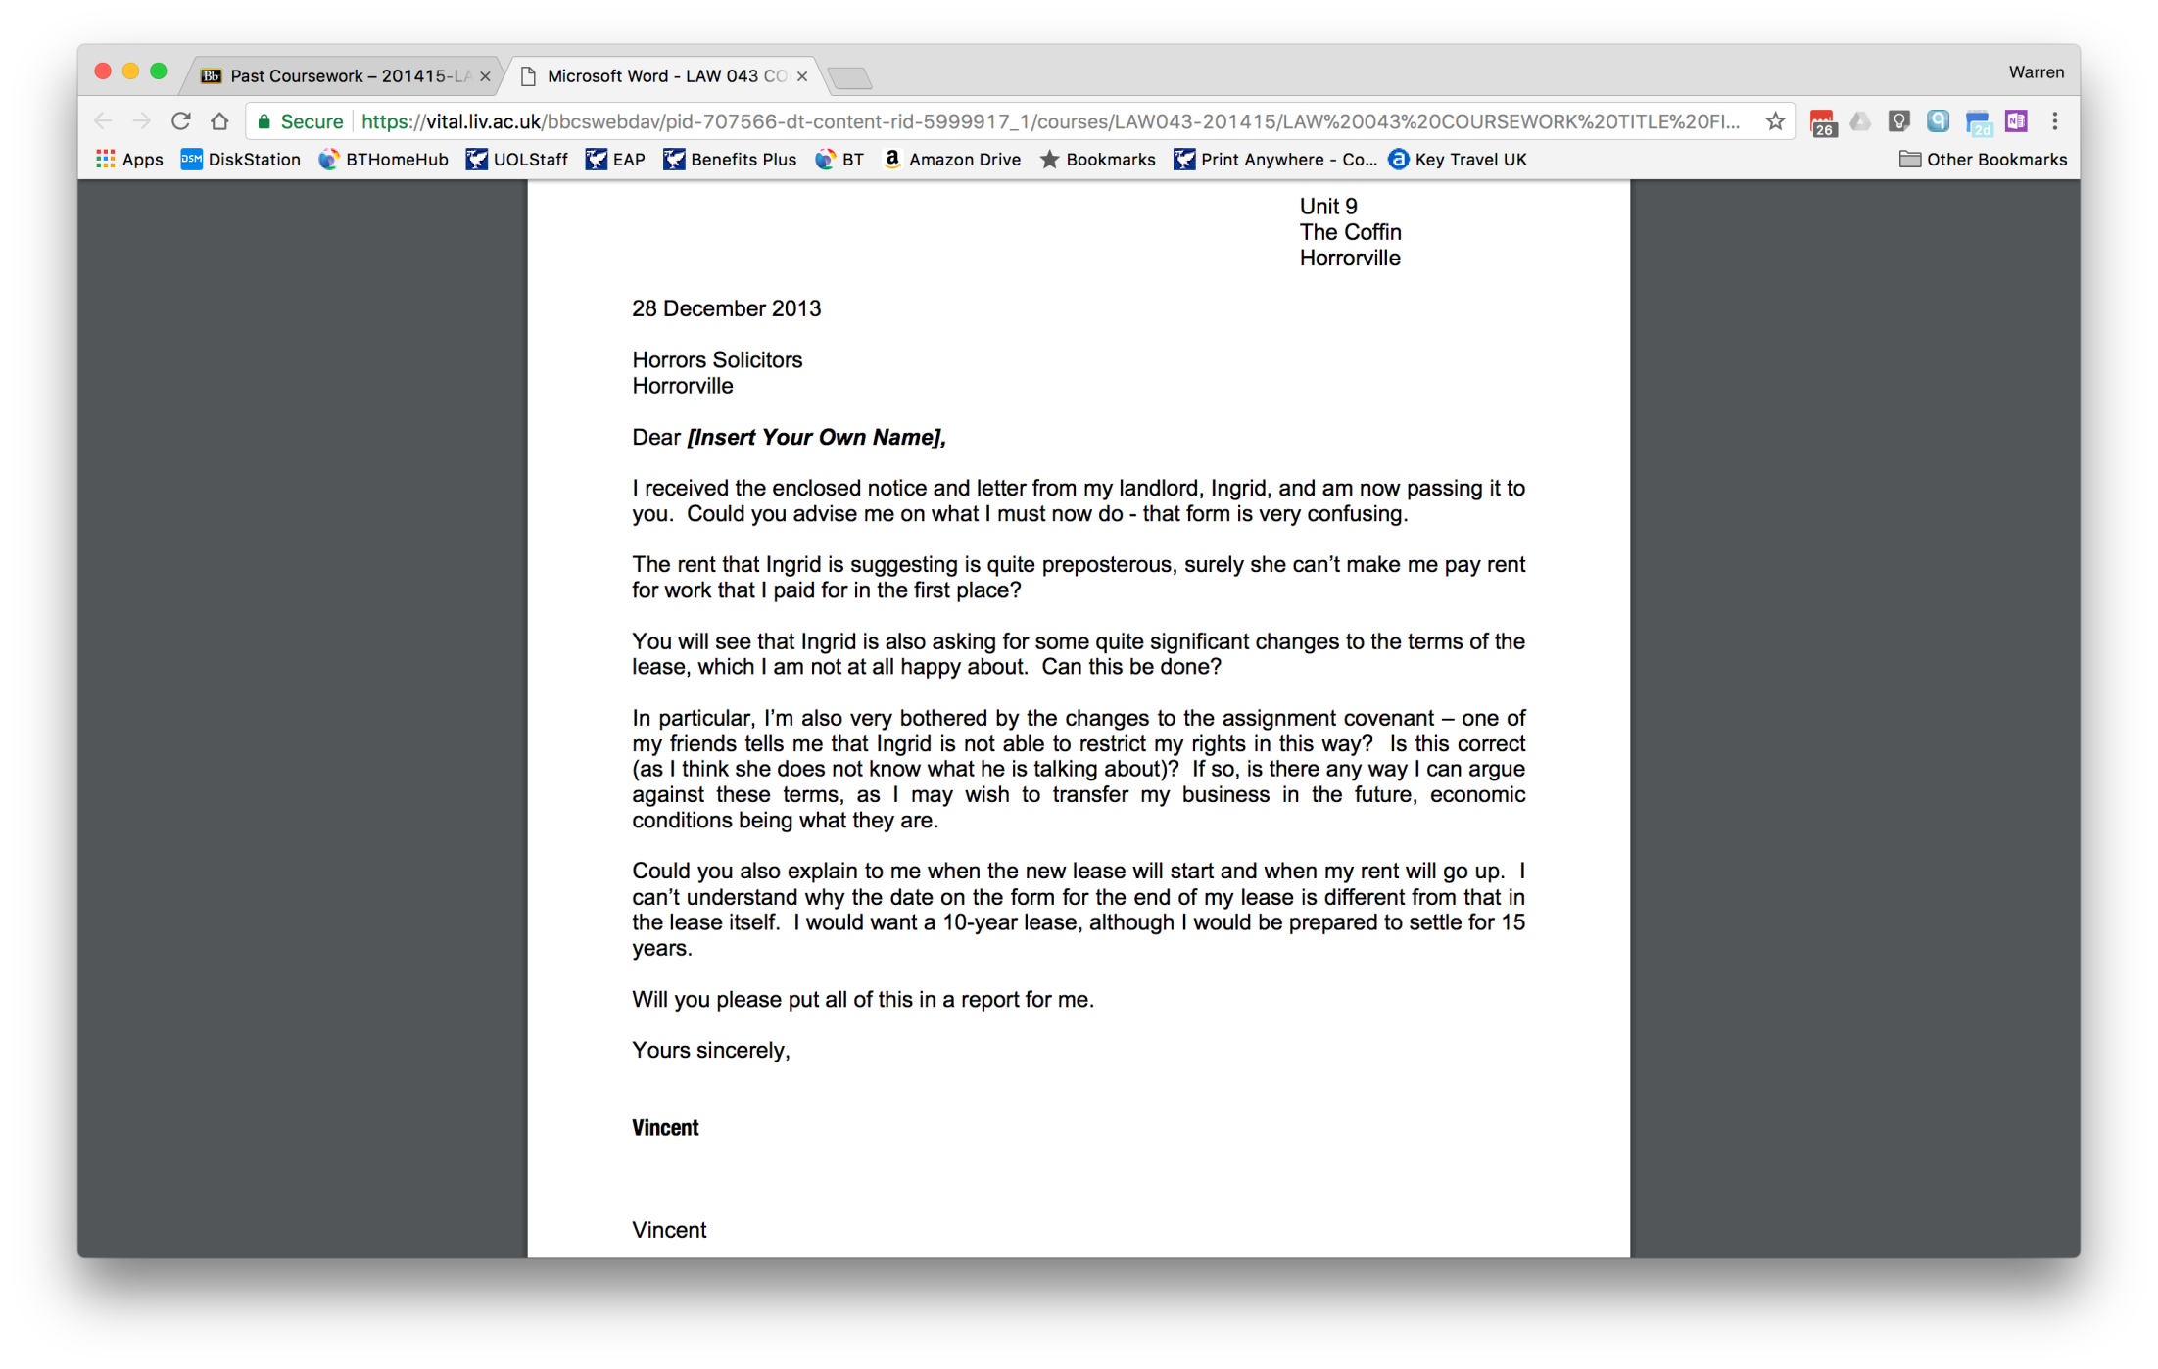

Slide 26
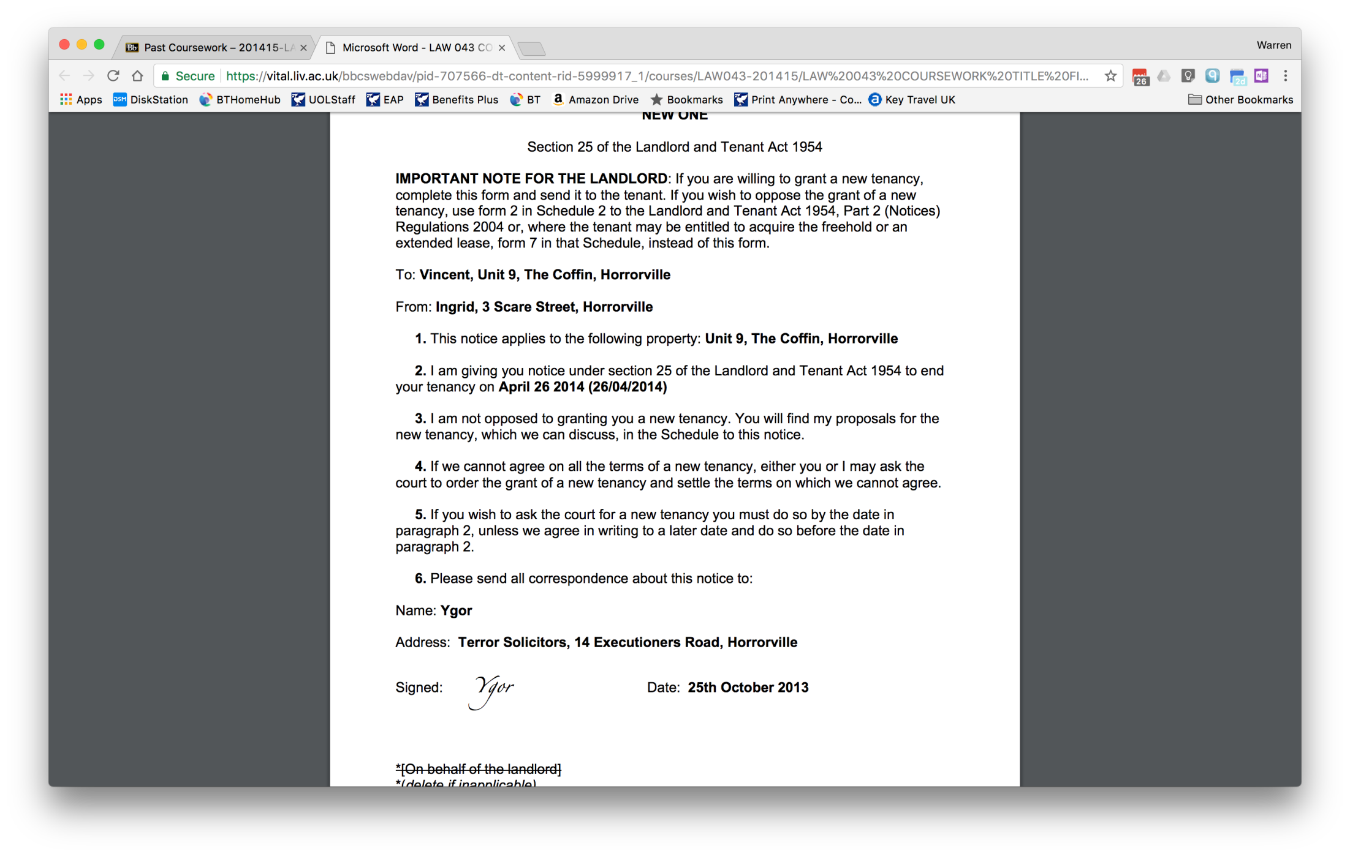
Notes:
Problem – piecing together from real world documents

Slide 27
Liverpool Law School
www.liv.ac.uk/law

